Slide 1
Introduction to
Mathematical Programming
OR/MA 504
Chapter 7
Nonlinear Programming & Evolutionary Optimization

Slide 2
Introduction to Nonlinear Programming (NLP)
An NLP problem has a nonlinear objective function and/or one or more nonlinear constraints.
NLP problems are formulated and implemented in virtually the same way as linear problems.
The mathematics involved in solving NLPs is quite different than for LPs.
Solver tends to mask this different but it is important to understand the difficulties that may be encountered when solving NLPs.

Slide 3
Possible Optimal Solutions to NLPs
(not occurring at corner points)
objective function level curve
objective function level curve
optimal solution
optimal solution
Feasible Region
Feasible Region
linear objective,
nonlinear constraints
nonlinear objective,
linear constraints
objective function level curve
objective function level curves
optimal solution
optimal solution
Feasible Region
Feasible Region
nonlinear objective,
nonlinear constraints
nonlinear objective,
linear constraints

Slide 4
The GRG Algorithm
Solver uses the Generalized Reduced Gradient (GRG) algorithm to solve NLPs.
GRG can also be used on LPs but is slower than the Simplex method.
The following discussion gives a general (but somewhat imprecise) idea of how GRG works.

Slide 5
An NLP Solution Strategy
X₂
C
D
B
E
objective function level curves
Feasible Region
A
(the starting point)
X₁

Slide 6
Local vs. Global Optimal Solutions
X₂
Local optimal solution
C
Local and global optimal solution
F
E
Feasible Region
B
G
A
D
X₁

Slide 7
Comments About NLP Algorithms
It is not always best to move in the direction producing the fastest rate of improvement in the objective.
NLP algorithms can terminate at local optimal solutions.
The starting point influences the local optimal solution obtained.

Slide 8
Comments About Starting Points
The null starting point should be avoided.
When possible, it is best to use starting values of approximately the same magnitude as the expected optimal values.

Slide 9
A Note About “Optimal” Solutions
When solving a NLP problem, Solver normally stops when the first of three numerical tests is satisfied, causing one of the following three completion messages to appear:
1) “Solver found a solution. All constraints and optimality conditions are satisfied.”
This means Solver found a local optimal solution, but does not guarantee that the solution is the global optimal solution.

Slide 10
A Note About “Optimal” Solutions
When solving a NLP problem, Solver normally stops when the first of three numerical tests is satisfied, causing one of the following three completion messages to appear:
2) “Solver has converged to the current solution. All constraints are satisfied.”
This means the objective function value changed very slowly for the last few iterations.

Slide 11
A Note About “Optimal” Solutions
When solving a NLP problem, Solver normally stops when the first of three numerical tests is satisfied, causing one of the following three completion messages to appear:
3) “Solver cannot improve the current solution. All constraints are satisfied.”
This rare message means the your model is degenerate and the Solver is cycling. Degeneracy can often be eliminated by removing redundant constraints in a model.

Slide 12
The Economic Order Quantity
(EOQ) Problem
Involves determining the optimal quantity to purchase when orders are placed.
Small orders result in:
  low inventory levels & carrying costs
  frequent orders & higher ordering costs
Large orders result in:
  higher inventory levels & carrying costs
  infrequent orders & lower ordering costs

Slide 13
Sample Inventory Profiles
Inventory
60
Annual Usage = 150
Number of Orders = 3
50
Order Size = 50
Avg Inventory = 25
40
30
20
10
0
0
1
2
3
4
5
6
7
8
9
10
11
12
Month
Inventory
60
Annual Usage = 150
Number of Orders = 6
50
Order Size = 25
Avg Inventory = 12.5
40
30
20
10
0
0
1
2
3
4
5
6
7
8
9
10
11
12
Month

Slide 14
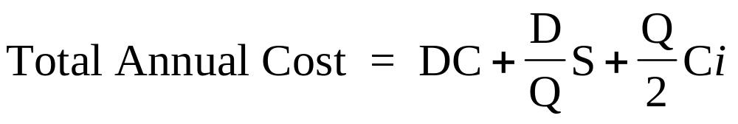
The EOQ Model
where:
D = annual demand for the item
C = unit purchase cost for the item
S = fixed cost of placing an order
i = cost of holding inventory for a year (expressed as a % of C)
Q = order quantity
Assumes:
  Demand (or use) is constant over the year.
  New orders are received in full when the inventory level drops to zero.

Slide 15
EOQ Cost Relationships
$
1000
800
Total Cost
600
400
Carrying Cost
200
Ordering Cost
EOQ
0
0
10
20
30
40
50
Order Quantity

Slide 16
An EOQ Example:
Ordering Paper For MetroBank
Alan Wang purchases paper for copy machines and laser printers at MetroBank.
  Annual demand (D) is for 24,000 boxes
  Each box costs $35 (C)
  Each order costs $50 (S)
  Inventory carrying costs are 18% (i)
What is the optimal order quantity (Q)?

Slide 17
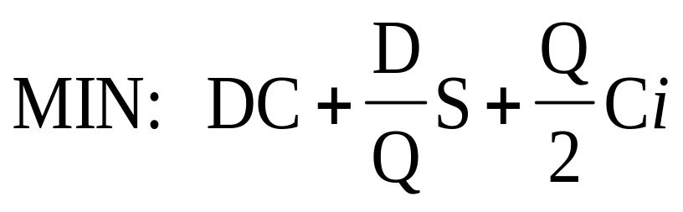
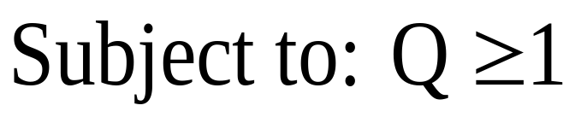
The Model
(Note the nonlinear objective!)

Slide 18
Implementing the Model
See file Fig7-1.xls

Slide 19
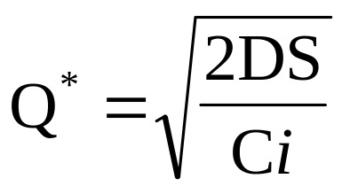
Comments on the EOQ Model
Using calculus, it can be shown that the optimal value of Q is:
Numerous variations on the basic EOQ model exist accounting for:
  quantity discounts
  storage restrictions
  backlogging
  etc

Slide 20
EOQ with Discounts: Crowley Foods
Crowley Foods needs 5,000 cartons of a particular item each year.
Each box costs $30 (C)
Each order costs $35 (S)
Inventory carrying costs are 10%
See file Fig. 7-2

Slide 21
Crowley Foods: Quantity Discounts
Crowley’s supplier offers quantity discounts:
Quantity Purchased Unit cost ($)
x ≤ 100 30.00
101 ≤ x ≤ 500 29.50
501 ≤ x 29.40
See file Fig. 7-2

Slide 22
Location Problems
Cape Rocheleau is a resort community served by a single road that on a map looks like a straight line 24 miles long.
Emergency call boxes are at mile markers 4, 6, 9, 13, 16, 18, and 21.
Police chief wants to locate a service vehicle on the road so that the sum of the distances to the call boxes is a minimum.
See file Fig. 7-3

Slide 23
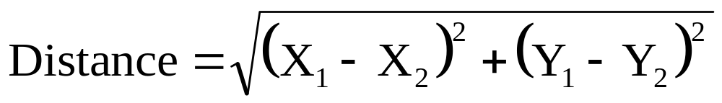
Location Problems
Many decision problems involve determining optimal locations for facilities or service centers. For example,
  Manufacturing plants
  Warehouse
  Fire stations
  Ambulance centers
These problems usually involve distance measures in the objective and/or constraints.
The straight line (Euclidean) distance between two points (X₁, Y₁) and (X₂, Y₂) is:

Slide 24
A Location Problem:
Rappaport Communications
Rappaport Communications provides cellular phone service in several mid-western states.
The want to expand to provide inter-city service between four cities in northern Ohio.
A new communications tower must be built to handle these inter-city calls.
The tower will have a 40 mile transmission radius.

Slide 25
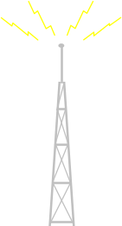
Graph of the Tower Location Problem
Y
50
Cleveland
x=5, y=45
40
30
Youngstown
Akron
x=52, y=21
20
x=12, y=21
10
Canton
x=17, y=5
0
X
0
10
20
30
40
50
60

Slide 26
Defining the Decision Variables
X₁ = location of the new tower with respect to the X-axis
Y₁ = location of the new tower with respect to the Y-axis

Slide 27
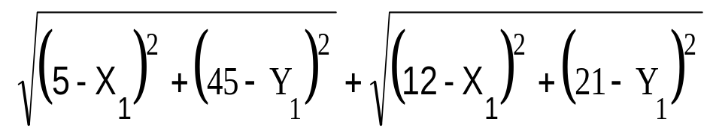
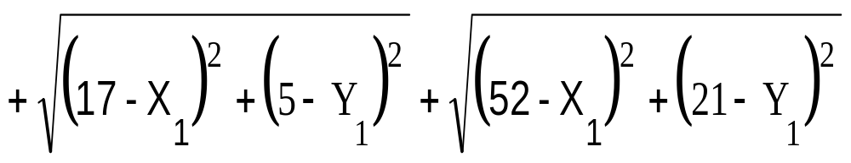
Defining the Objective Function
Minimize the total distance from the new tower to the existing towers
MIN:

Slide 28
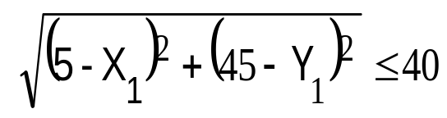
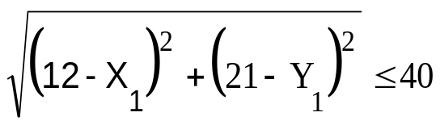
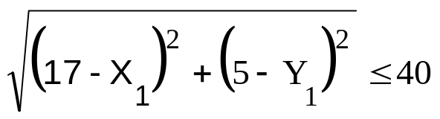
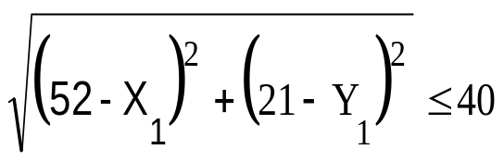
Defining the Constraints
Cleveland
Akron
Canton
Youngstown

Slide 29
Implementing the Model
See file Fig7-4.xls

Slide 30
Analyzing the Solution
The optimal location of the “new tower” is in virtually the same location as the existing Akron tower.
Maybe they should just upgrade the Akron tower.
The maximum distance is 39.8 miles to Youngstown.
This is pressing the 40 mile transmission radius.
Where should we locate the new tower if we want the maximum distance to the existing towers to be minimized?

Slide 31
Implementing the Model
See file Fig7-5.xls

Slide 32
Comments on Location Problems
The optimal solution to a location problem may not work:
  The land may not be for sale.
  The land may not be zoned properly.
  The “land” may be a lake.
In such cases, the optimal solution is a good starting point in the search for suitable property.
Constraints may be added to location problems to eliminate infeasible areas from consideration.

Slide 33
A Nonlinear Network Flow Problem:
The SafetyTrans Company
SafetyTrans specialized in trucking extremely valuable and extremely hazardous materials.
It is imperative for the company to avoid accidents:
  It protects their reputation.
  It keeps insurance premiums down.
  The potential environmental consequences of an accident are disastrous.
The company maintains a database of highway accident data which it uses to determine safest routes.
They currently need to determine the safest route between Los Angeles, CA and Amarillo, TX.

Slide 34
Network for the SafetyTrans Problem
Las
Vegas
2
0.006
0.001
+1
Albu-querque
8
0.001
Flagstaff
6
Amarillo
10
0.003
0.010
0.006
0.004
Los
Angeles
1
0.002
0.009
0.010
Phoenix
4
0.005
0.006
-1
0.004
0.002
0.002
0.003
Lubbock
9
0.003
Las
Cruces
7
San
Diego
3
Tucson
5
0.010
Numbers on arcs represent the probability of an accident occurring.

Slide 35
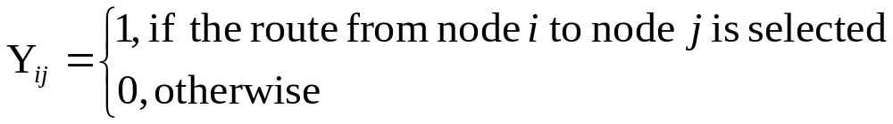
Defining the Decision Variables

Slide 36
Defining the Objective
Select the safest route by maximizing the probability of not having an accident,
MAX: (1-P₁₂Y₁₂)(1-P₁₃Y₁₃)(1-P₁₄Y₁₄)(1-P₂₄Y₂₄)…(1-P_{9,10}Y_{9,10})
where:
P_{ij} = probability of having an accident while traveling between node i and node j

Slide 37
Defining the Constraints
Flow Constraints
-Y₁₂ -Y₁₃ -Y₁₄ = -1 } node 1
+Y₁₂ -Y₂₄ -Y₂₆ = 0 } node 2
+Y₁₃ -Y₃₄ -Y₃₅ = 0 } node 3
+Y₁₄ +Y₂₄ +Y₃₄ -Y₄₅ -Y₄₆ -Y₄₈ = 0 } node 4
+Y₃₅ +Y₄₅ -Y₅₇ = 0 } node 5
+Y₂₆ +Y₄₆ -Y₆₇ -Y₆₈ = 0 } node 6
+Y₅₇ +Y₆₇ -Y₇₈ -Y₇₉ -Y_{7,10} = 0 } node 7
+Y₄₈ +Y₆₈ +Y₇₈ -Y_{8,10} = 0 } node 8
+Y₇₉ -Y_{9,10} = 0 } node 9
+Y_{7,10} +Y_{8,10} +Y_{9,10} = 1 } node 10

Slide 38
Implementing the Model
See file Fig7-6.xls

Slide 39
Comments on Nonlinear
Network Flow Problems
Small differences in probabilities can mean large differences in expected values:
  0.9900 * $30,000,000 = $2,970,000
  0.9626 * $30,000,000 = $1,122,000
This type of problem is also useful in reliability network problems (e.g., finding the weakest “link” (or path) in a production system or telecommunications network).

Slide 40
A Project Selection Problem:
The TMC Corporation
TMC needs to allocate $1.7 million of R&D budget and up to 25 engineers among 6 projects.
The probability of success for each project depends on the number of engineers assigned (X_{i}) and is defined as:
P_{i} = X_{i}/(X_{i} + ε_{i})
Project 1 2 3 4 5 6
Startup Costs $325 $200 $490 $125 $710 $240
NPV if successful $750 $120 $900 $400 $1,110 $800
Probability
Parameter ε_{i} 3.1 2.5 4.5 5.6 8.2 8.5
(all monetary values are in $1,000s)

Slide 41
Selected Probability Functions
Prob. of Success
1.0000
Project 2 - ε = 2.5
0.9000
0.8000
Project 4 - ε = 5.6
0.7000
0.6000
Project 6 - ε = 8.5
0.5000
0.4000
0.3000
0.2000
0.1000
0.0000
0
1
2
3
4
5
6
7
8
9
10
11
12
13
14
15
16
17
18
19
20
21
22
23
24
25
Engineers Assigned

Slide 42
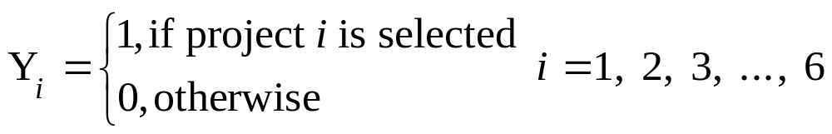
Defining the Decision Variables
X_{i} = the number of engineers assigned to project i, i = 1, 2, 3, …, 6

Slide 43
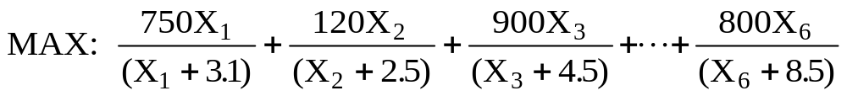
Defining the Objective
Maximize the expected total NPV of selected projects

Slide 44
Defining the Constraints
Startup Funds
  325Y₁ + 200Y₂ + 490Y₃ + 125Y₄ + 710Y₅ + 240Y₆ <=1700
Engineers
  X₁ + X₂ + X₃ + X₄ + X₅ + X₆ <= 25
Linking Constraints
  X_{i} - 25Y_{i} <= 0, i= 1, 2, 3, … 6
Note: The following constraint could be used in place of the last two constraints...
  X₁Y₁ + X₂Y₂+ X₃Y₃+ X₄Y₄+ X₅Y₅ + X₆Y₆ <= 25
However, this constraint is nonlinear. It is generally better to keep things linear where possible.

Slide 45
Implementing the Model
See file Fig7-7.xls

Slide 46
Optimizing Existing Financial Models
It is not necessary to always write out the algebraic formulation of an optimization problem, although doing so ensures a thorough understanding of the problem.
Solver can be used to optimize a host of pre-existing spreadsheet models which are inherently nonlinear.

Slide 47
A Life Insurance Funding Problem
Thom Pearman owns a whole life policy with surrender value of $6,000 and death benefit of $40,000.
He’d like to cash in his whole life policy and use interest on the surrender value to pay premiums on a a term life policy with a death benefit of $350,000.
The premiums on the new policy for the next 10 years are:
Year 1 2 3 4 5 6 7 8 9 10
Premium $423 $457 $489 $516 $530 $558 $595 $618 $660 $716
Thom’s marginal tax rate is 28%.
What rate of return will be required on his $6,000 investment?

Slide 48
Implementing the Model
See file Fig7-8.xls

Slide 49
The Portfolio Optimization Problem
A financial planner wants to create the least risky portfolio with at least a 12% expected return using the following stocks.
Annual Return
Year IBC NMC NBS
1 11.2% 8.0% 10.9%
2 10.8% 9.2% 22.0%
3 11.6% 6.6% 37.9%
4 -1.6% 18.5% -11.8%
5 -4.1% 7.4% 12.9%
6 8.6% 13.0% -7.5%
7 6.8% 22.0% 9.3%
8 11.9% 14.0% 48.7%
9 12.0% 20.5% -1.9%
10 8.3% 14.0% 19.1%
11 6.0% 19.0% -3.4%
12 10.2% 9.0% 43.0%
Avg 7.64% 13.43% 14.93%
Covariance Matrix
IBC NMC NBS
IBC 0.00258 -0.00025 0.00440
NMC -0.00025 0.00276 -0.00542
NBS 0.00440 -0.00542 0.03677

Slide 50
Defining the Decision Variables
p₁ = proportion of funds invested in IBC
p₂ = proportion of funds invested in NMC
p₃ = proportion of funds invested in NBS

Slide 51
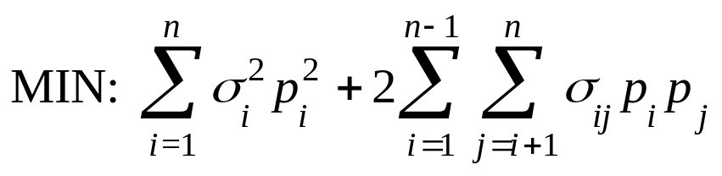
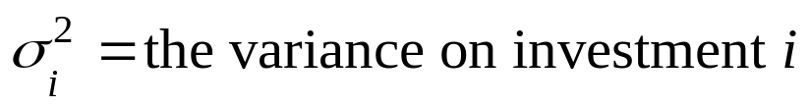
Defining the Objective
Minimize the portfolio variance (risk).

Slide 52
Defining the Constraints
Expected return
  0.0764 p₁ + 0.1343 p₂ + 0.1493 p₃ >= 0.12
Proportions
p₁ + p₂ + p₃ = 1
p₁, p₂, p₃ >= 0
p₁, p₂, p₃ <= 1

Slide 53
Implementing the Model
See file Fig7-9.xls

Slide 54
The Efficient Frontier
Portfolio Variance
0.04000
0.03500
0.03000
0.02500
0.02000
Efficient Frontier
0.01500
0.01000
0.00500
0.00000
10.00%
10.50%
11.00%
11.50%
12.00%
12.50%
13.00%
13.50%
14.00%
14.50%
15.00%
Portfolio Return

Slide 55
Multiple Objectives in Portfolio Optimization
In portfolio problems we usually want to either:
  Minimize risk (portfolio variance)
  Maximize the expected return
We can deal with both objectives simultaneously as follows to generate efficient solutions:
  MAX: (1-r)(Expected Return) - r(Portfolio Variance)
  S.T.: p₁ + p₂ + … + p_{m} = 1
  p_{i} >= 0
  where:
  0<= r <=1 is a user defined risk aversion value
  Note: If r = 1 we minimize the portfolio variance.
  If r = 0 we maximize the expected return.

Slide 56
Implementing the Model
See file Fig7-10.xls

Slide 57
Sensitivity Analysis
LP Term NLP Term Meaning
Shadow Price Lagrange Multiplier Marginal value of resources.
Reduced Cost Reduced Gradient Impact on objective of small changes in optimal values of decision variables.
Less sensitivity analysis information is available with NLPs vs. LPs.
See file Fig7-11.xls

Slide 58
Evolutionary Algorithms
A technique of heuristic mathematical optimization based on Darwin’s Theory of Evolution.
Can be used on any spreadsheet model, including those with “If” and/or “Lookup” functions.
Also known as Genetic Algorithms (GAs).

Slide 59
Evolutionary Algorithms
Solutions to a MP problem can be represented as a vector of numbers (like a chromosome)
Each chromosome has an associated “fitness” (obj) value
GAs start with a random population of chromosomes & apply
  Crossover - exchange of values between solution vectors
  Mutation - random replacement of values in a solution vector
The most fit chromosomes survive to the next generation, and the process is repeated

Slide 60
INITIAL POPULATION
Chromosome X₁ X₂ X₃ X₄ Fitness
1 7.84 24.39 28.95 6.62 282.08
2 10.26 16.36 31.26 3.55 293.38
3 3.88 23.03 25.92 6.76 223.31
4 9.51 19.51 26.23 2.64 331.28
5 5.96 19.52 33.83 6.89 453.57
6 4.77 18.31 26.21 5.59 229.49
CROSSOVER & MUTATION
Chromosome X₁ X₂ X₃ X₄ Fitness
1 7.84 24.39 31.26 3.55 334.28
2 10.26 16.36 28.95 6.62 227.04
3 3.88 19.75 25.92 6.76 301.44
4 9.51 19.51 32.23 2.64 495.52
5 4.77 18.31 33.83 6.89 332.38
6 5.96 19.52 26.21 4.60 444.21
NEW POPULATION
Chromosome X₁ X₂ X₃ X₄ Fitness
1 7.84 24.39 31.26 3.55 334.28
2 10.26 16.36 31.26 3.55 293.38
3 3.88 19.75 25.92 6.76 301.44
4 9.51 19.51 32.23 2.64 495.52
5 5.96 19.52 33.83 6.89 453.57
6 5.96 19.52 26.21 4.60 444.21
Crossover
Mutation

Slide 61
Example: Beating The Market
An investor would like to determine portfolio allocations that maximizes the number of times his portfolio outperforms the S&T 500.
See file Fig7-12.xls

Slide 62
The Traveling Salesperson Problem
A salesperson wants to find the least costly route for visiting clients in n different cities, visiting each city exactly once before returning home.
n (n-1)!
3 2
5 24
9 40,320
13 479,001,600
17 20,922,789,888,000
20 121,645,100,408,832,000

Slide 63
Example:The Traveling Salesperson Problem
Wolverine Manufacturing needs to determine the shortest tour for a drill bit to drill 9 holes in a fiberglass panel.
See file Fig7-13.xls

Slide 64
End of Chapter 7

